Slide 1

PYTHON
INTRODUCTION

Slide 2
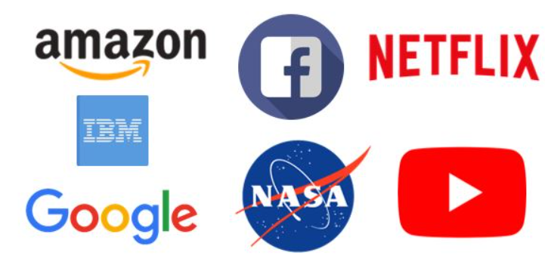
WHY PYTHON
Career Opportunities

Slide 3
WHY PYTHON
Data Science
Machine Learning
Artificial Intelligence
Web Application
Scripting and automation

Slide 4
WHY PYTHON
Data science and ML
Pytorch
Sympy
Scikit learning
Pandas
PyBrain
Tensor flow
Matplotlib

Slide 5
WHY PYTHON
Web application frameworks
Django
Flask
Pyramid

Slide 6
WHY PYTHON
Active community
Open-Source Library

Slide 7
CONTENTS
Data type
Variables
Expression
Control Flow
Loops
Object Oriented Programming
File Handling
Exception Handling
Python Modules

Slide 8
Data Type
Built in Data Type
User Defined Data Type

Slide 9

Variables
&
Expression

Slide 10
Control Flow
Condition
Boolean Expression
Conditional Statements
If- else statement
elif statement

Slide 11
Loops
For loop
While Loop

Slide 12
OBJECT ORIENTED PROGRAMMING
Objects
Classes
Inheritance
Polymorphism
Encapsulation

Slide 13
File Handling
Exception Handling
Python Modules

